Slide 1
The making of PriceHub
An app by Carlos Flores, Ahmad Adil, Jia Cong Lin, and Steven Granaturov
Notes:
Ahmad

Slide 2


Intro
Problem: People love shopping at many different places. A problem that arises from this is too many prices to keep track of.
PriceHub will improve your online shopping experience!
Saving you time and your money with a broad selection of items from major store brands like Amazon, Walmart, and eBay.
Notes:
Jia
You can save more time and go to your favorite hub.

Slide 3


Previous Work and Competitors:
Honey is a browser extension that allows users to compare prices between different stores and shows price history, however there is no mobile app.
PCPARTPICKER is one of our competitors, but they only offer pc parts and not a wide variety of goods.
Notes:
Steven

Slide 4
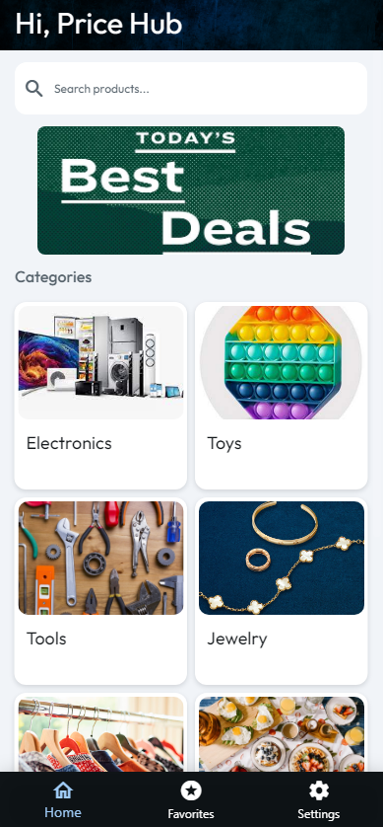
Approach
Features included in our app:
Log-in as guest or personal account
Language
Profile customizations
Display Name
Feedback
Best Deals
Categories
Product Display
Compare Prices
Favorite items (in progress)
Redirect to Store Page
Notes:
Carlos

Slide 5
Implementation
Gestures and User Interface
User interface was divided into six main parts:
Login page
The login page allows users to login using email or Google Authentication
Sign up page
The sign up page allows users to sign up utilizing email or Google Authentication
Categories
This would allow users to quickly see deals for products in their respective categories
Search
The main focal point. Allows to search for products and compare prices from various different stores
Results
A comprehensive results page that allows for products to dynamically displayed
Product Display
The product display page would display the product images, prices and buttons to redirect users to the respective stores
Notes:
Ahmad

Slide 6
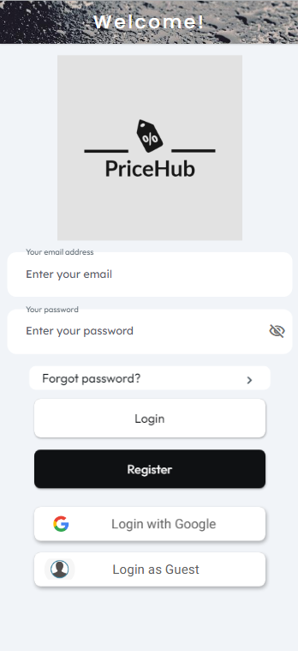
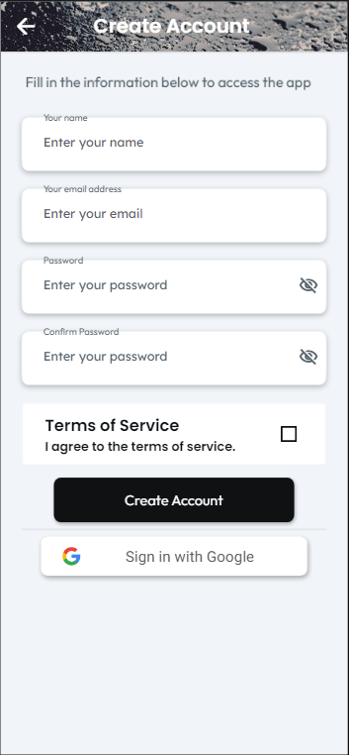
Log in/Sign-up
Allows User to make an account, login with Google, or login as a guest account.
Notes:
Jia

Slide 7
Categories/Search
Categories serves the role of the homepage after user login.
Access to favorites and their profile settings
Users can then proceed to search for an item of their choosing or visit the best deals of the day or a preferred category.
Sends the requested product or category to Amazon through the API
Notes:
Jia

Slide 8
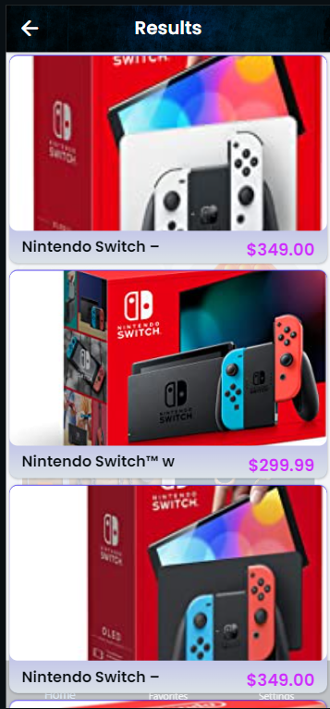
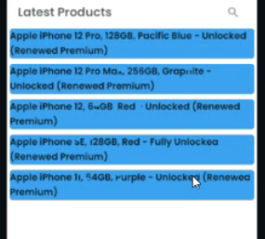
Results
The results page appears from the user’s search, categories or best deals
The results page shows the list of products, with the respective Amazon price, from the search that the user initiated.
Each Product is displayed automatically using an API call from the backend
The API returns a JSON file which contains crucial information such as Product title, Price, and image.
Notes:
Jia

Slide 9
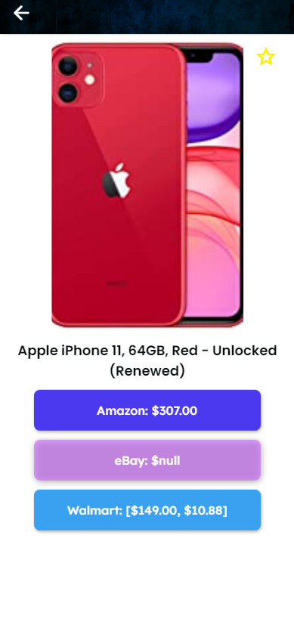
Product Display
Page will consist of variables passed from the results page and present the image, name, price, and URL to the user
The page will pull the name and image from Amazon
The page will show prices on Amazon, eBay, and Walmart
If user wants to go to a specific store, the button will redirect them to the respective stores website, leading them to the item
Users can click the star icon at top right to favorite the item
Notes:
Jia

Slide 10
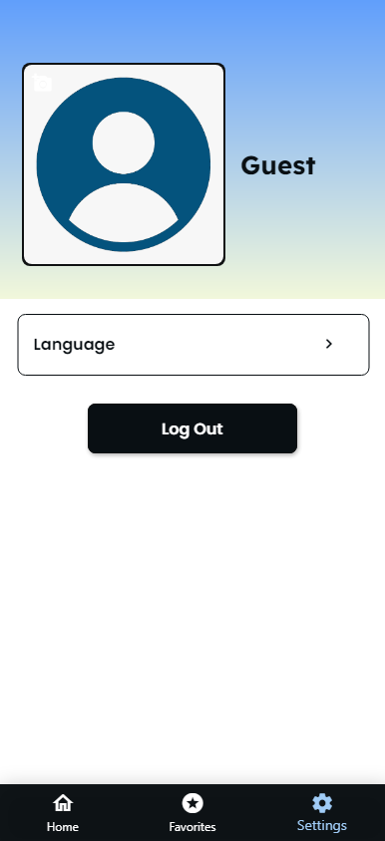
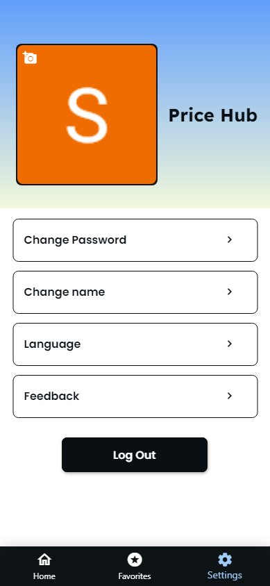

User Profile Page
Users are able to change the language of the app.
If users are signed-in, they are able to customize their profile by changing their profile picture, profile name, and their password.
Users are also able to send feedback and if the feedback was sent successfully, a success screen will pop-up.
Notes:
Jia

Slide 11
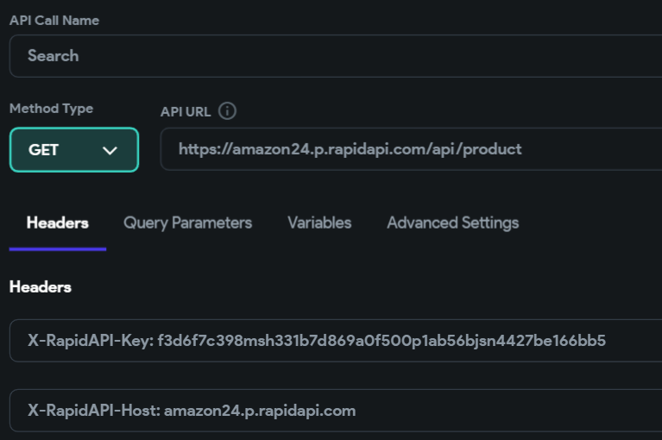
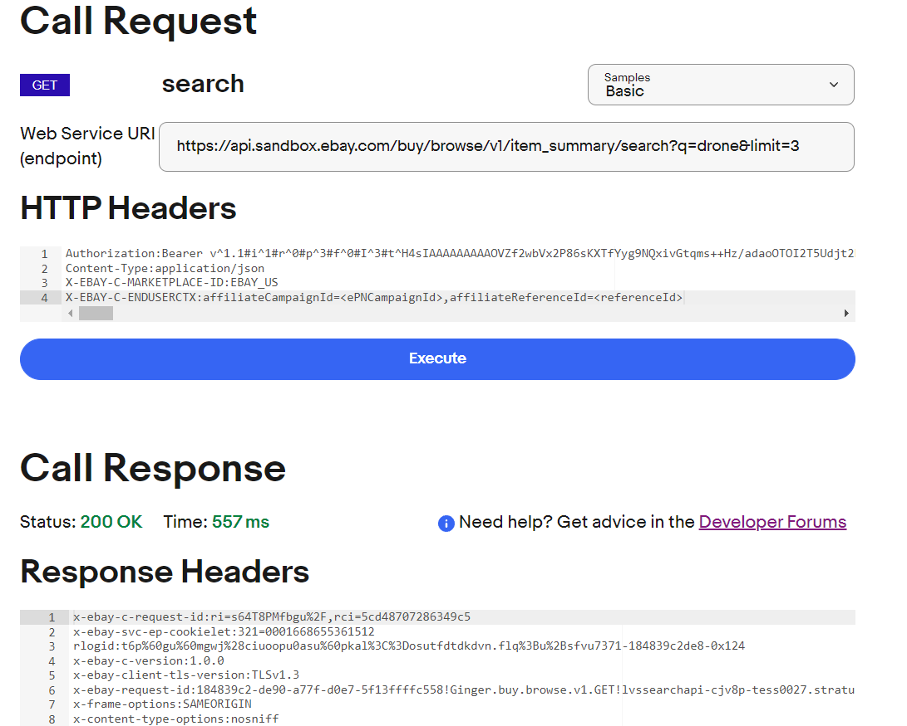
Implementation
Libraries used
We utilized FlutterFlow’s built in libraries for managing the user interface
We utilized APIs that were sourced from RapidAPI.com and the Ebay developer program.
The rapid APIs were implemented utilizing the documentation provided on the website
The Ebay API was first tested within Ebay’s sandbox environment to ensure it would and then be ported over to flutterflow.
Notes:
Ahmad

Slide 12
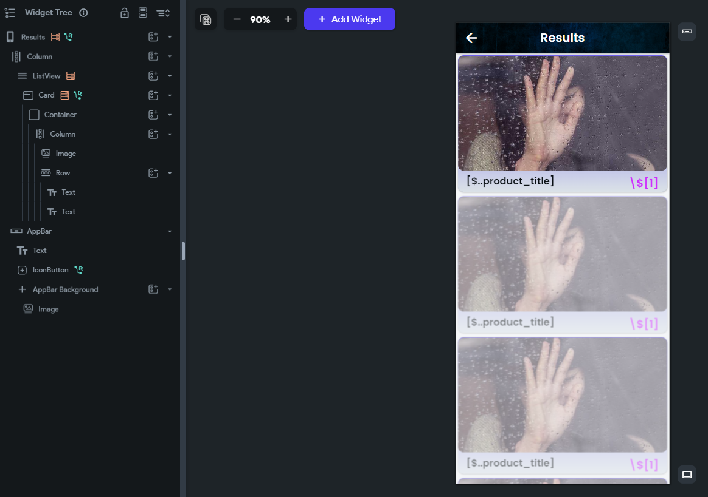
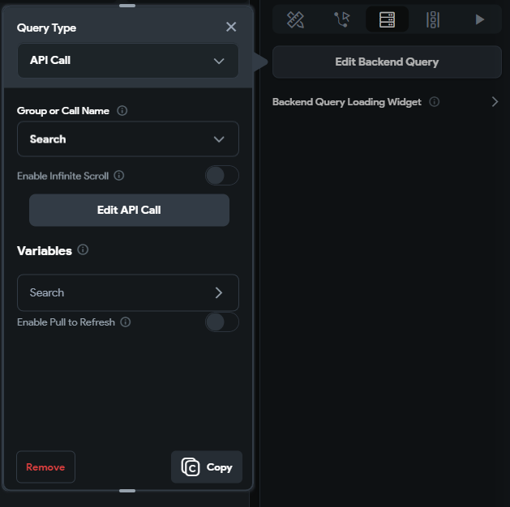
Implementation
Show source code for key implementation solutions
https://app.flutterflow.io/run/dnLgZs8qlYueYupzOvAe
Notes:
Carlos

Slide 13
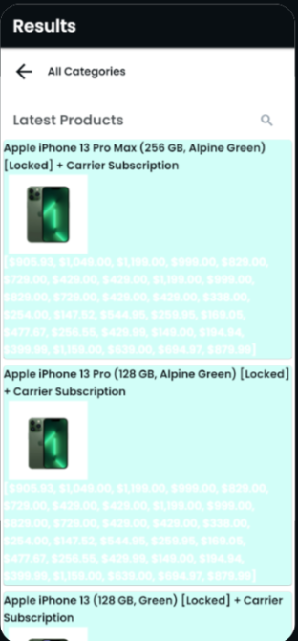
Implementation
Describe what challenges you faced and how you overcame them
We faced a lot of API challenges:
Had to figure out how to connect API in FlutterFlow
Had to figure out how to do implementation calls within the app
Had to parse through the JSON and find the info we are looking for and how to get that information
Had to figure out how to obtain prices from other stores when obtaining results from one store
eBay token
We also had UI challenges:
Names of Users were sometimes not shown
List view was showing the same product
How we overcame them:
Google and Youtube
Met together to offer solutions to each other
FlutterFlow and eBay documentation
Asked other groups for assistance
Notes:
Jia

Slide 14
Implementation - Tools used
Flutterflow:
We were able to design a front end system and implement the back end to make the application functional.
We used the Pro plan in order to access more than 2 API calls, along with other features such as the implementation of using different languages.
RapidAPI:
A hub of public and private APIs created to obtain certain data and display on an app.
This is where we were able to obtain all of our APIs along with their documentation.
We pay RapidAPI to get a certain amount of monthly calls as the free plan doesn’t give us a sufficient amount of calls.
eBay Developers Program:
We used the official eBay API by signing up for their developer program.
The Ebay API was first tested within Ebay’s sandbox environment to ensure it would and then be ported over to flutterflow.
Notes:
Steven

Slide 15
Division of Labor
Carlos Flores | Ahmad Adil | Steven Granaturov | Jia Cong Lin
Created UI designs Implemented API and UI connections Implemented Languages, Results, Product Display and Favorites | Extensive API research and implementation API maintenance and changes. Tested and built the Ebay API and authentication | Populated all the category pages and assisted on implementing other pages Researched numerous APIs and helped with implementations Took care of all the finances of the project | Parsed through JSON Helped with implementing the API’s Fixed Bugs like Google Sign-in and words becoming invisible
Notes:
Ahmad

Slide 16
Future Improvements
More Functionality:
More stores and more products
Add more features that will only be supported to users with accounts (i.e. Ability to favorite items)
Add more login options such as Facebook or Apple ID
Aesthetics:
Redesign the User Interface to be more accessible
Speed:
Attempt to speed up the app - Takes a long time for the app to fetch the results from API calls.
Revenue:
Incorporate advertisements to generate money for the app. Specifically, an idea in mind is to display an add while the app fetches the results from the API calls.
Notes:
Steven

Slide 17
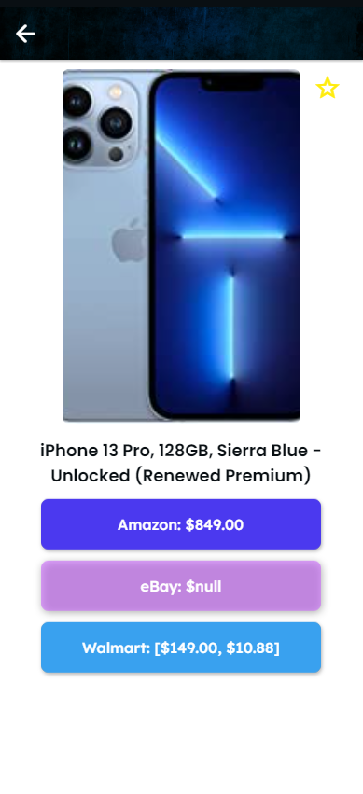
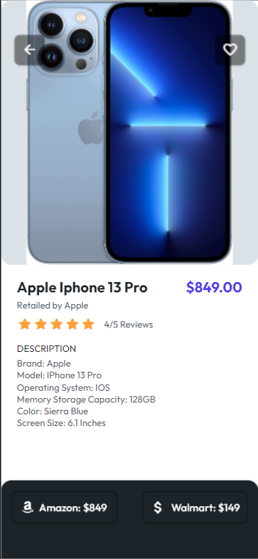
Notes:
Steven

Slide 18
What We Learned
Describe what you learned from this experience, Include information about project management, coding, libraries, etc.
FlutterFlow
UI designs
API implementations
Firebase
RapidAPI
eBay Developer Program
Notes:
Steven

Slide 19

Conclusion
We have implemented Amazon, Walmart, and eBay into our app, but just need to work out the minor issue with the prices shown and fix the “favorite” section along with making UI changes.
Notes:
Steven

